Slide 1

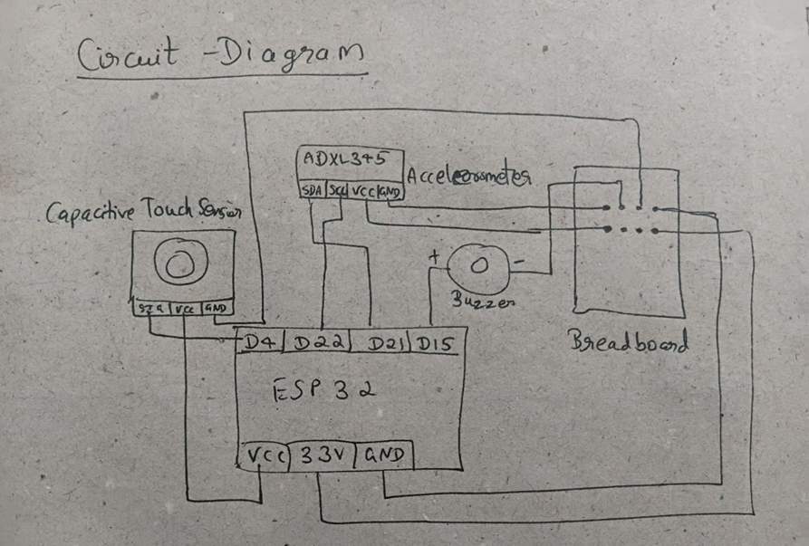
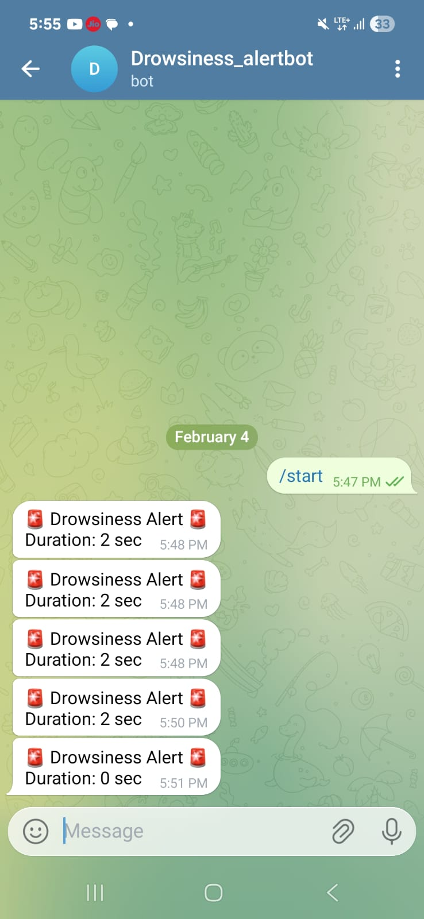
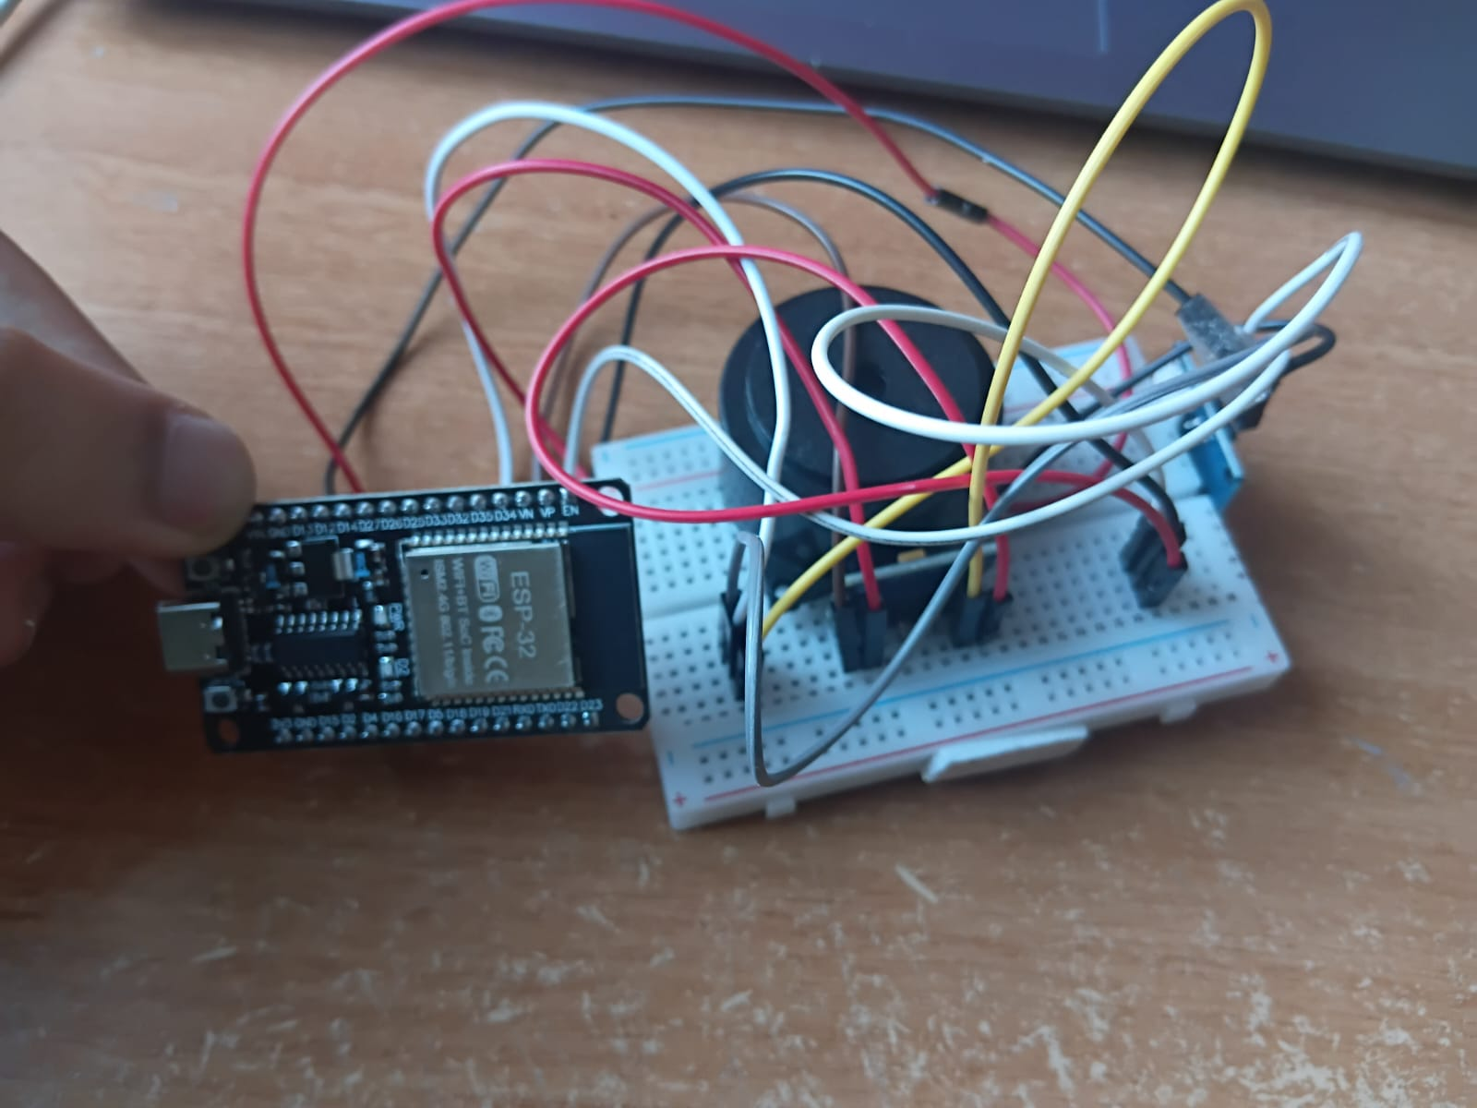
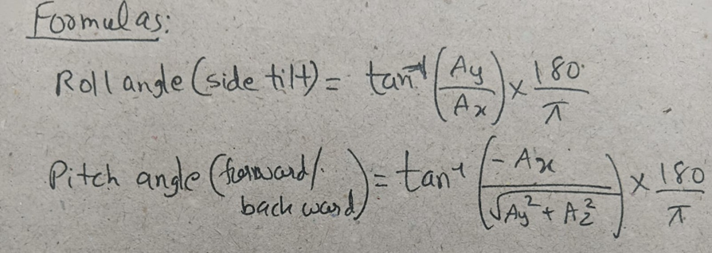
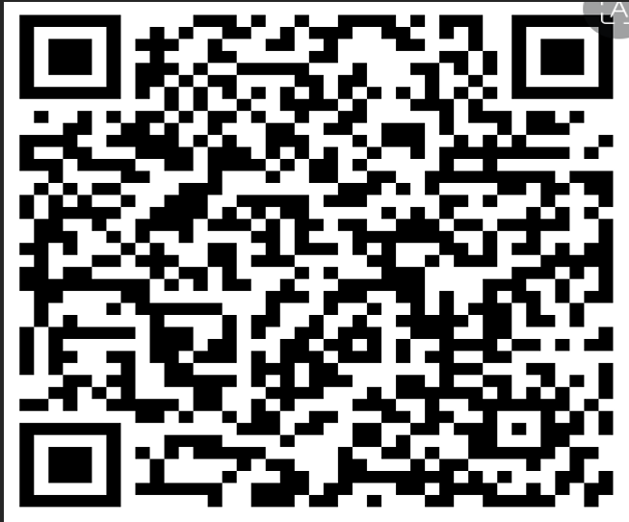









RV College of Engineering, Bengaluru – 560059.
Go, change the world
Anti-Sleep Driver Cap Alarm System
Branch: ECE
Section: C
^{V}
IDEA LAB SEE Project - I SEM
Samrudh S Malali | Sanchit Kumar | Shashank Kota | Sarvajit
RVCE25BEC159 | RVCE25BEC195 | RVCE25BEC118 | RVCE25BEC127 G Anjaneya Sir Dr. Gangadhar Angadi Sir
n
Introduction
Results & Discussions
This project addresses the critical issue of driver drowsiness, a major cause of road accidents globally. The objective is to design a compact, wearable safety system using an ADXL345 accelerometer to detect head tilt movements associated with microsleep. The system interfaces with an Arduino Uno to process real-time orientation data and triggers an auditory alert via a buzzer when unsafe thresholds are exceeded.
1. Accurate detection of drowsy head movements
• The ADXL345 correctly identifies:
o Forward head drop (common sign of microsleep)
o Side tilts beyond safe limits
• Sensitivity and thresholds worked reliably after calibration.
2. Fast response time
• The buzzer alarm activates within milliseconds of detecting unsafe tilt.
• This immediate response is crucial to prevent accidents.
3. Reliable manual override
• The touch sensor quickly silences the buzzer.
• Prevents false alarms from becoming annoying.
• Allows the driver to regain control of the system.
4. Low power consumption
• All components operate on low voltage (3.3V/5V).
• Suitable for battery-powered operation inside a vehicle.
5.Accuracy:
The system successfully distinguishes between normal head movements (checking mirrors) and drowsy nodding (sustained forward tilt).
6.Latency:
The buzzer activates within milliseconds of the threshold breach, ensuring an immediate wake-up signal.
7.Reliability:
The inclusion of a touch sensor prevents the alarm from becoming a distraction during false positives (e.g., bumpy roads).
Objectives
Drowsiness Detection: To continuously monitor head positioning using 3-axis acceleration data to identify sudden drooping or forward tilting.
Instantaneous Alerting: To provide an immediate auditory warning strong enough to wake the driver upon detecting unsafe movements.
Safety Enhancement: To offer a low-cost, non-intrusive alternative to commercial monitoring systems, thereby reducing accident risks.
Methodology
Sensing: The ADXL345 accelerometer continuously measures X, Y, and Z-axis acceleration data.
Processing: Arduino Uno reads sensor data via I2C protocol. It calculates the tilt angle relative to a calibrated "upright" position.
Decision Logic: If Tilt Angle > Threshold (e.g., 20° forward): Trigger Alarm. If Touch Sensor Pressed: Reset Alarm.
Actuation: A buzzer sounds continuously until the head returns to a safe position or the driver manually resets the system.
Testing/Validation & Feedback
Test Case 1 (Normal Driving): Head stays within vertical range
Outcome: Silent (Pass).
Test Case 2 (Microsleep Simulation): Head tilts forward
Outcome: Buzzer Triggers Instantly (Pass).
Test Case 3 (Manual Reset): Driver taps touch sensor during alarm
Outcome: Buzzer Stops (Pass) and again new cycle of monitoring is started.
Measurable Outcomes
Response Time: < 1 second reaction to unsafe tilt of the driver during sleepy.
Power Consumption: Low voltage operation (3.3V/5V), making it battery-portable.
Cost: Significantly cheaper than camera-based commercial eye-tracking systems.
Avoids road accidents during driving especially for the logistics drivers carry heavy load for longer distance and time
Empirical, Calculations, Tools & Techniques
References
FORMULAS
Hardware Tools:
Microcontroller: Arduino Uno (ATmega328P)
Sensor: ADXL345 Digital Accelerometer
Input/Output: Capacitive Touch Sensor & Active Buzzer.
Techniques:
I2C Communication: Interfacing sensors (SDA/SCL) for rapid data transfer.
Threshold Calibration: Establishing "safe" vs. "sleep" angles during setup
S. A. P. Pradana et al., "IMU-Based Early Warning System for Driver Drowsiness Detection via Head Movement Analysis," Journal of Physics: Conf. Series, 2025.
N. Kiruthiga et al., "Arduino based real time driver drowsiness detection," IJECS, vol. 5, 2018.M.
S. M. Aras et al., "Head movement-based driver drowsiness detection: A review," IEEE Sensors Journal, 2023.
QR codes
QR Code of Demonstration of the prototype /design simulation
QR Code of
Project POSTER
QR Code of
Project REPORT
2025-2026

